Slide 1


Time Series Analysis
統計所 黃皓謙

Slide 2

Time series data
Stationary
ARMA(p,q) model
Analysis flowchart
Test for stationary
Model specification
Parameter estimation
Model diagnostic
Model selection
Conclusion
auto.arima()

Slide 3

1. Time series data

Slide 4

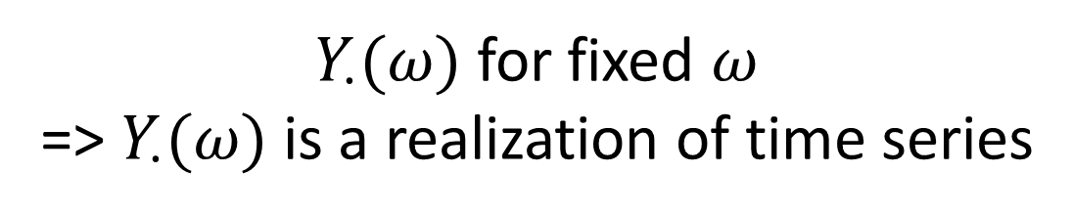
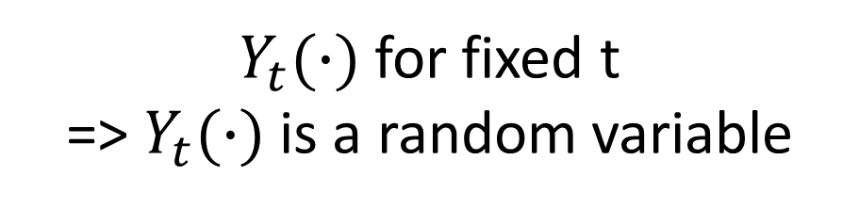
Cross-section data
Times series data
不同Sample的data
同個sample在不同時間的data
$Y_{t}(∙)$ for fixed t
=> $Y_{t}(∙)$ is a random variable
$Y_{∙}(ω)$ for fixed $ω$
=> $Y_{∙}(ω)$ is a realization of time series
${\{Y}_{t} |$ t = 0, $±$1, $±$2,…} is called a stochastic process

Slide 5
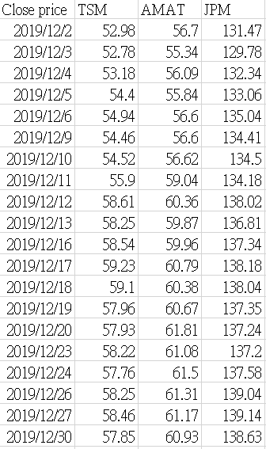
Cross-section data
Time series data

Slide 6

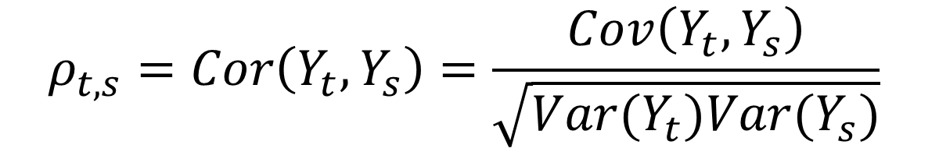

Mean function
Autocovariance function
$μ_{t}$= E[$Y_{t}$]
$$γ_{t,s}=Cov\left(Y_{t},Y_{s}\right)=E[\left(Y_{t}−μ_{t}\right)\left(Y_{s}−μ_{s}\right)]$$
Autocorrelation function (ACF)
$$ρ_{t,s}=Cor\left(Y_{t},Y_{s}\right)=\frac{Cov\left(Y_{t},Y_{s}\right)}{\sqrt{Var(Y_{t})Var(Y_{s})}}$$

Slide 7
2. Stationary

Slide 8
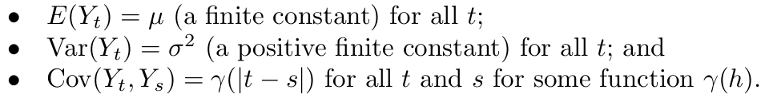

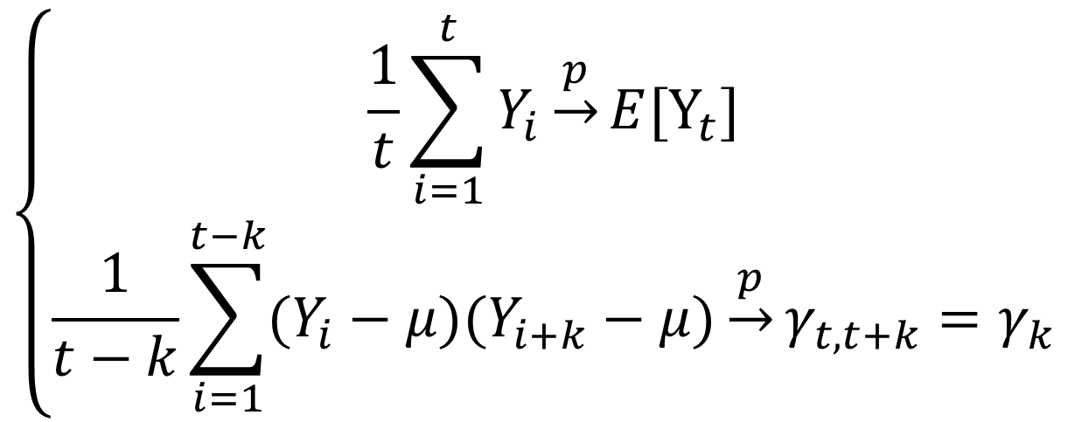
To make some statistical inference, we need “stationary” assumption.
Strictly stationary
$$\left\{\begin{aligned}\frac{1}{t}\sum_{i=1}^{t}{Y_{i}\underset{→}{p}E[Y_{t}]} \\ \frac{1}{t−k}\sum_{i=1}^{t−k}{(Y_{i}−μ)(Y_{i+k}−μ)\underset{→}{p}γ_{t,t+k}=γ_{k}}\end{aligned}\right.$$
Stationary
n-th order stationary
Weakly stationary (2-nd order stationary)
Stability in parameter estimation
Reliability in prediction
Interpretability of the model
Stationary

Slide 9
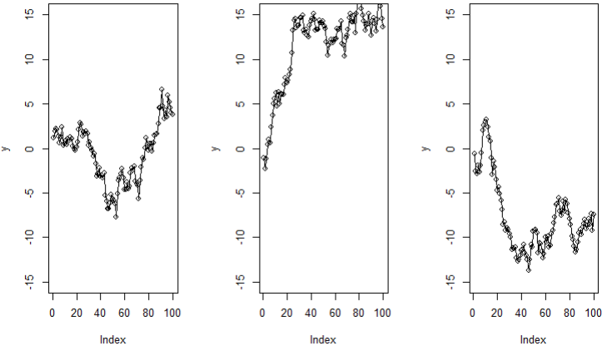

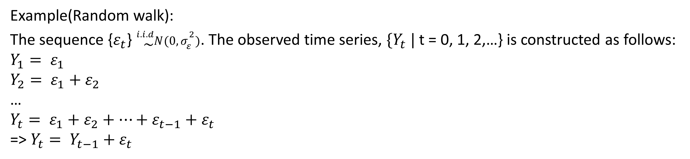
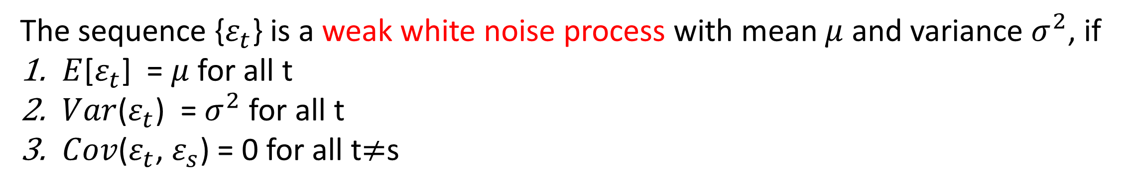
The sequence {$ε_{t}$} is a weak white noise process with mean $μ$ and variance $σ^{2}$, if
$E$[$ε_{t}$] = $μ$ for all t
$Var$($ε_{t}$) = $σ^{2}$ for all t
$Cov$($ε_{t}$, $ε_{s}$) = 0 for all t$≠$s
Example(Random walk):
The sequence {$ε_{t}$} ${}_{\sim }^{i.i.d}{N(0,σ_{ε}^{2})}$. The observed time series, ${\{Y}_{t} |$ t = 0, 1, 2,…} is constructed as follows:
$$Y_{1}= ε_{1}$$
$$Y_{2}= ε_{1}+ε_{2}$$
…
$$Y_{t}= ε_{1}+ε_{2}+…+ε_{t−1}+ε_{t}$$
=> $Y_{t}= Y_{t−1}+ε_{t}$
Q: Is the figure look like stationary?

Slide 10


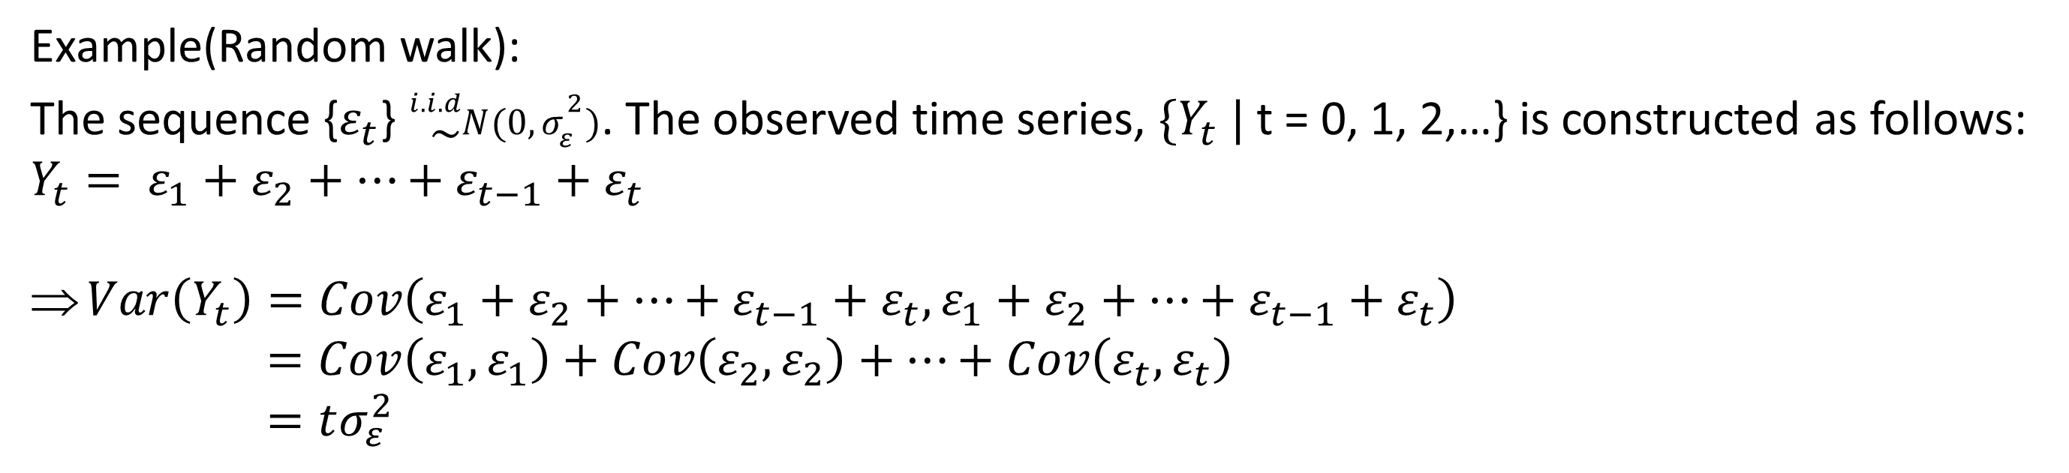
Example(Random walk):
The sequence {$ε_{t}$} ${}_{\sim }^{i.i.d}{N(0,σ_{ε}^{2})}$. The observed time series, ${\{Y}_{t} |$ t = 0, 1, 2,…} is constructed as follows:
$$Y_{t}= ε_{1}+ε_{2}+…+ε_{t−1}+ε_{t}$$
$Var\left(Y_{t}\right)=Cov\left(ε_{1}+ε_{2}+…+ε_{t−1}+ε_{t},ε_{1}+ε_{2}+…+ε_{t−1}+ε_{t}\right)$
$=Cov\left(ε_{1},ε_{1}\right)+Cov\left(ε_{2},ε_{2}\right)+…+Cov\left(ε_{t},ε_{t}\right)$
$=tσ_{ε}^{2}$
Q: Is the figure look like stationary?
A: Non-stationary!!!

Slide 11
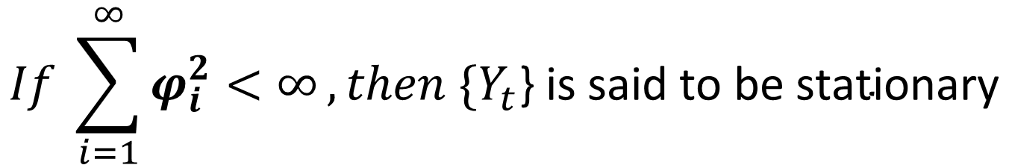
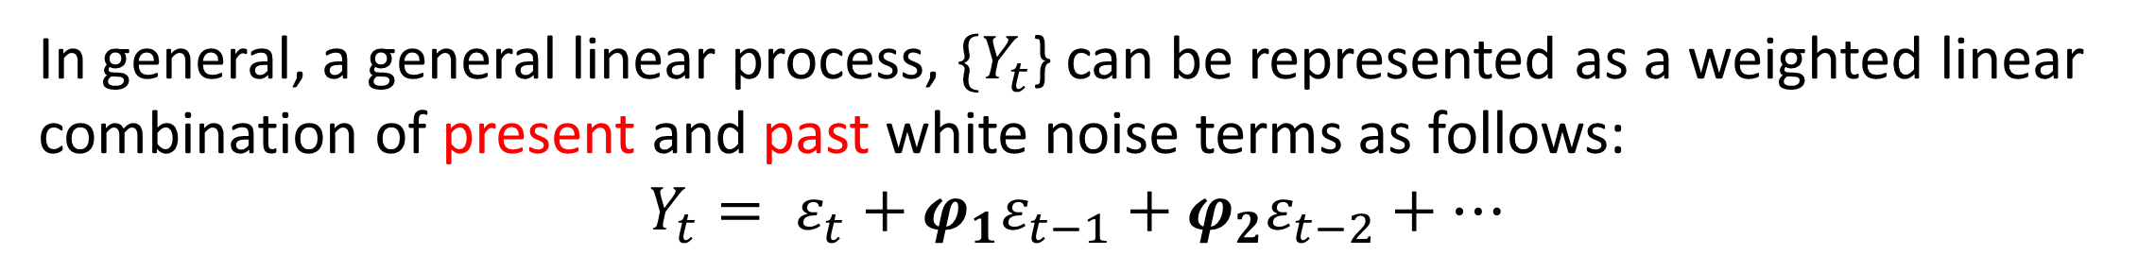
In general, a general linear process, ${\{Y}_{t}$} can be represented as a weighted linear combination of present and past white noise terms as follows:
$$Y_{t}= ε_{t}+{φ_{1}ε}_{t−1}+{φ_{2}ε}_{t−2}+…$$
$$If \sum_{i=1}^{∞}{φ_{i}^{2}<∞},then{ \{Y}_{t}\text{\}} \text{is} \text{said} \text{to} \text{be} \text{stationary}$$

Slide 12
3. ARMA(p,q) model

Slide 13

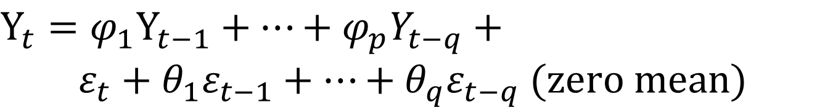
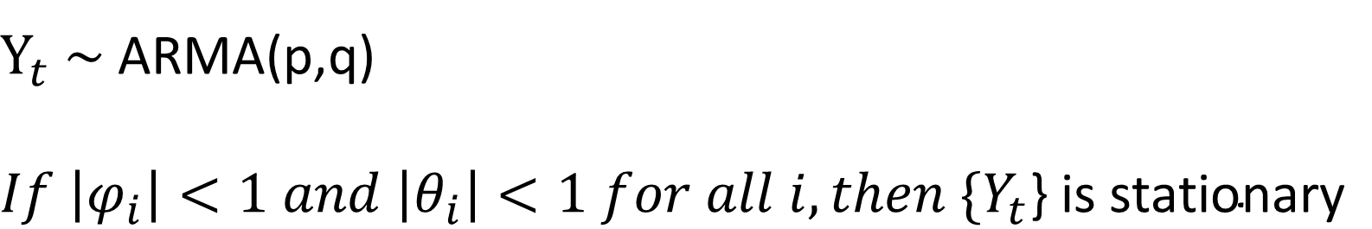
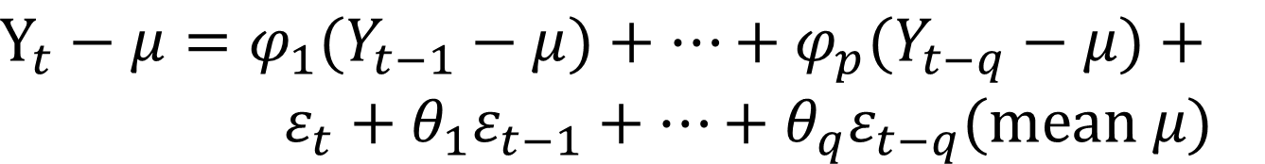
MA(q): Moving average model with lag q
$$Y_{t}=ε_{t}+{θ_{1}ε}_{t−1}+…+{θ_{q}ε}_{t−q} (zero mean)$$
$$Y_{t}=μ+ε_{t}+{θ_{1}ε}_{t−1}+…+{θ_{q}ε}_{t−q} (mean μ)$$
ARMA(p,q)
$$Y_{t}={φ_{1}Y}_{t−1}+…+{φ_{p}Y}_{t−q}+$$
$$ε_{t}+{θ_{1}ε}_{t−1}+…+{θ_{q}ε}_{t−q} (zero mean)$$
AR(p): Autoregressive model with lag p
$$Y_{t}={φ_{1}Y}_{t−1}+…+{φ_{p}Y}_{t−q}+ε_{t}(zero mean)$$
$$Y_{t}−μ={φ_{1}(Y}_{t−1}−μ)+…+{φ_{p}(Y}_{t−q}−μ)+$$
$ε_{t}+{θ_{1}ε}_{t−1}+…+{θ_{q}ε}_{t−q}(mean μ)$
$$Y_{t}−μ={φ_{1}(Y}_{t−1}−μ)+…+{φ_{p}(Y}_{t−q}−μ)+ε_{t}(mean μ)$$
$Y_{t}$ ~ ARMA(p,q)
$$If \left|φ_{i}\right|<1 and \left|θ_{i}\right|<1 for all i,then{ \{Y}_{t}\text{\}} \text{is} \text{stationary}$$

Slide 14
4. Analysis flowchart

Slide 15


ARMA model analysis flowchart
Data
Test for
stationary
Model specification
Parameter estimation
Model diagnostic
Model selection

Slide 16
5. Test for stationary

Slide 17
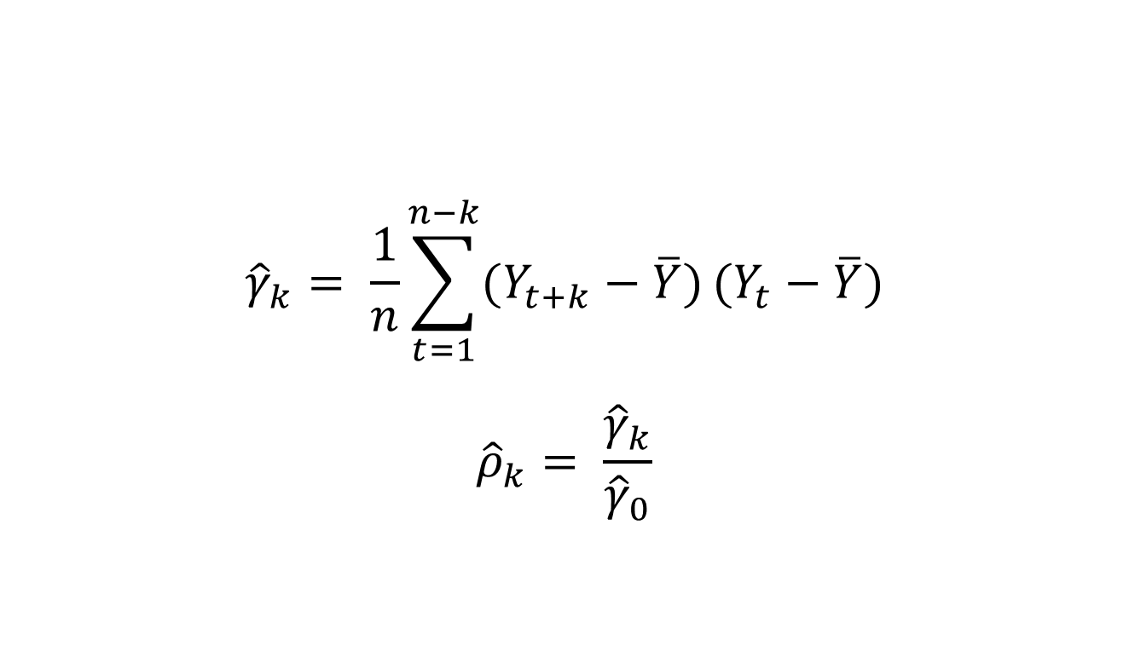
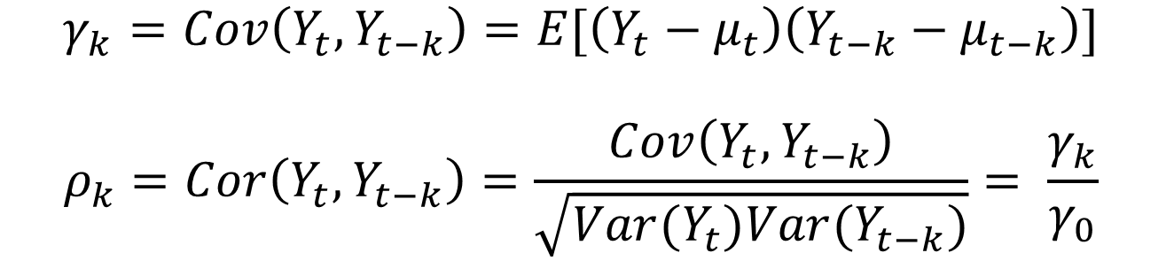
ARMA model analysis flowchart
Data
ADF-test (H0: Data is non-stationary)
KPSS-test (H0: Data is stationary)
ACF plot
R code:
adf.test(data)
kpss.test(data)
Test for
stationary
Model specification
Theoretical ACF
$$γ_{k}=Cov\left(Y_{t},Y_{t−k}\right)=E[\left(Y_{t}−μ_{t}\right)\left(Y_{t−k}−μ_{t−k}\right)]$$
$$ρ_{k}=Cor\left(Y_{t},Y_{t−k}\right)=\frac{Cov\left(Y_{t},Y_{t−k}\right)}{\sqrt{Var(Y_{t})Var(Y_{t−k})}}= \frac{γ_{k}}{γ_{0}}$$
Parameter estimation
Sample ACF
Model diagnostic
$${\hat{γ}}_{k}= \frac{1}{n}\sum_{t=1}^{n−k}{(Y_{t+k}−\overline{Y})}(Y_{t}−\overline{Y})$$
$${\hat{ρ}}_{k}= \frac{{\hat{γ}}_{k}}{{\hat{γ}}_{0}}$$
Model selection

Slide 18
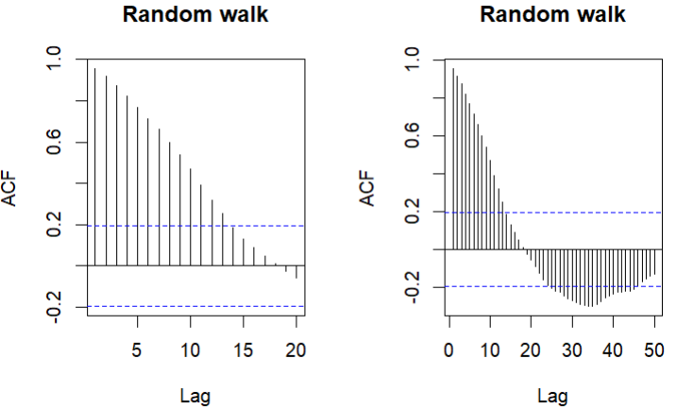
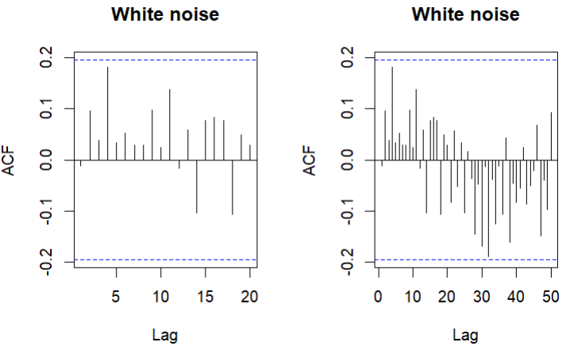
ARMA model analysis flowchart
Data
ADF-test (H0: Data is non-stationary)
KPSS-test (H0: Data is stationary)
ACF plot
Test for
stationary
Model specification
ACF plot:
Non-stationary
Stationary
Parameter estimation
Model diagnostic
Model selection

Slide 19
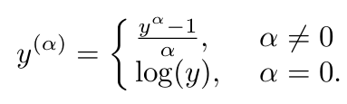

ARMA model analysis flowchart
Data
ADF-test (H0: Data is non-stationary)
KPSS-test (H0: Data is stationary)
ACF plot
Test for
stationary
Model specification
Stationary
Non-stationary
Parameter estimation
Box-Cox transformation
Difference
1. Box-Cox transformation:
2. Difference:
Model diagnostic
$$Y_{t}^{∗}= Y_{t} − Y_{t−1}$$
Model selection
R code: BoxCox.ar(data)
R code: diff(data)

Slide 20
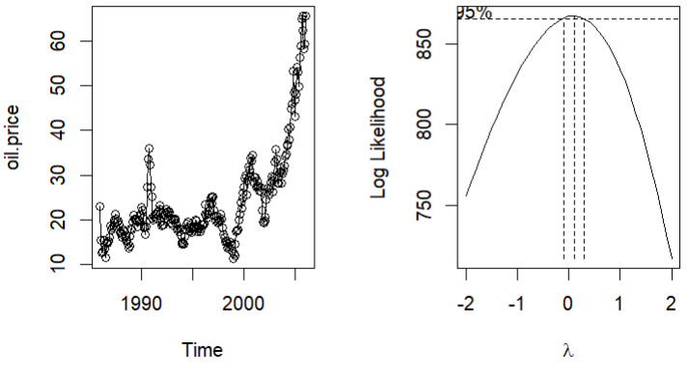
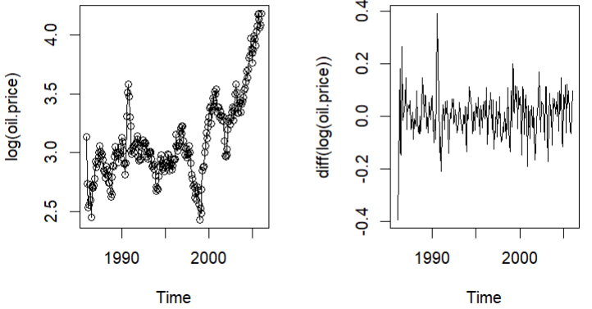
ARMA model analysis flowchart
Data
ADF-test (H0: Data is non-stationary)
KPSS-test (H0: Data is stationary)
ACF plot
Test for
stationary
Model specification
Stationary
Non-stationary
Parameter estimation
Box-Cox transformation
Difference
Example(oil.price):
Model diagnostic
Model selection

Slide 21
6. Model specification

Slide 22
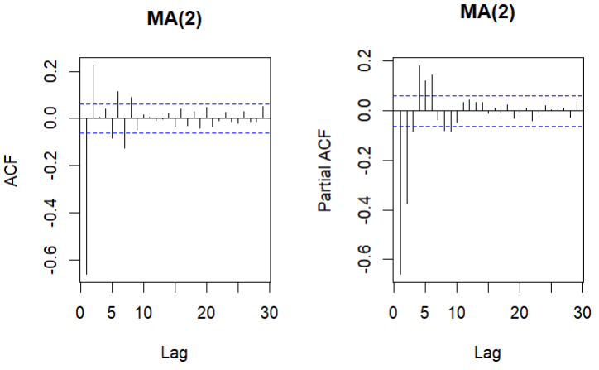
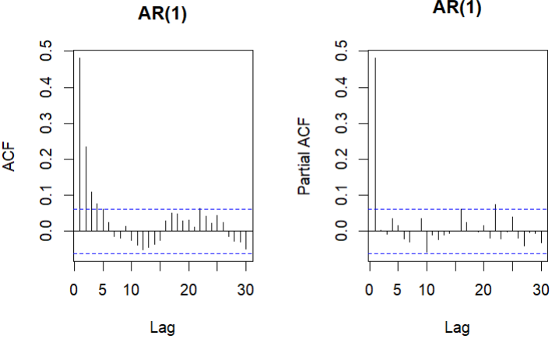
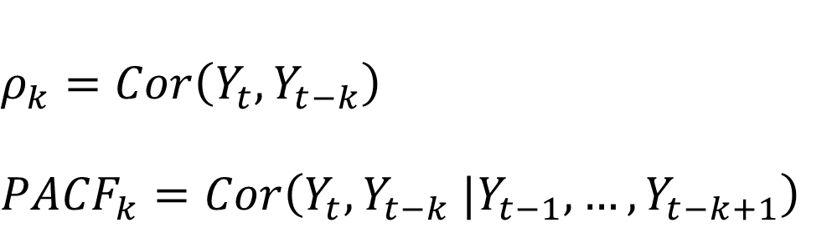
ARMA model analysis flowchart
Data
$$ρ_{k}=Cor\left(Y_{t},Y_{t−k}\right)$$
$${PACF}_{k}=Cor\left(Y_{t},Y_{t−k} |Y_{t−1},…,Y_{t−k+1}\right)$$
Test for
stationary
ACF plot
PACF plot
EACF plot
 | MA | AR
ACF | Cut-off | Decline
PACF | Decline | Cut-off
Model specification
Parameter estimation
Model diagnostic
Model selection

Slide 23
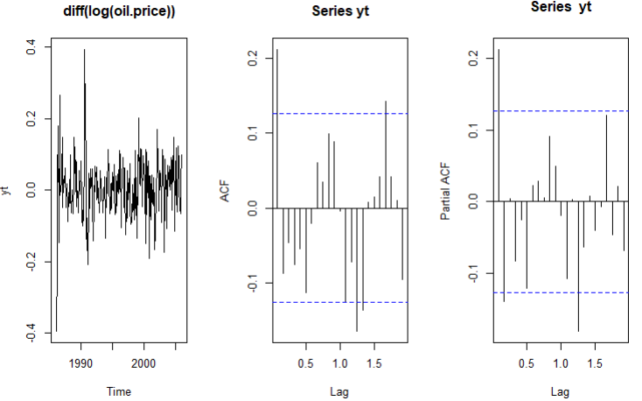
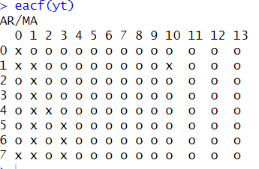
ARMA model analysis flowchart
Data
 | MA | AR
ACF | Cut-off | Decline
PACF | Decline | Cut-off
Test for
stationary
ACF plot: Cut-off at lag q => MA(q)
PACF plot: Cut-off at lag p => AR(p)
EACF plot: ARMA(p,q)
Model specification
Example(oil.price):
Parameter estimation
Model diagnostic
Model selection

Slide 24
7. Parameter estimation

Slide 25
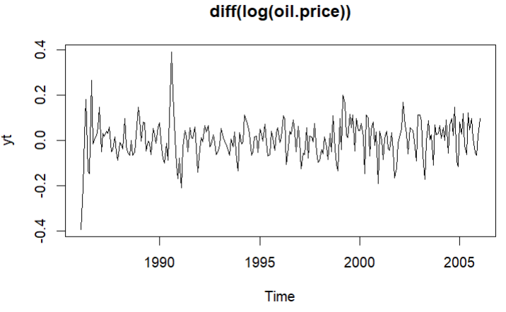
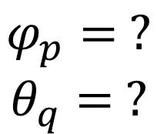
ARMA model analysis flowchart
Data
Example(oil.price):
R code:
arima(data, order=c(p,d,q))
Test for
stationary
Model specification
Maximum Likelihood Estimation(MLE)
Least Square Estimation(LSE)
$$φ_{p}= ?$$
$$θ_{q}= ?$$
Parameter estimation
Check significance of parameters
Refit the model
Model diagnostic
All of parameters are significance
Some parameters are non-significance
Remove the most non-significance parameter
Model selection

Slide 26
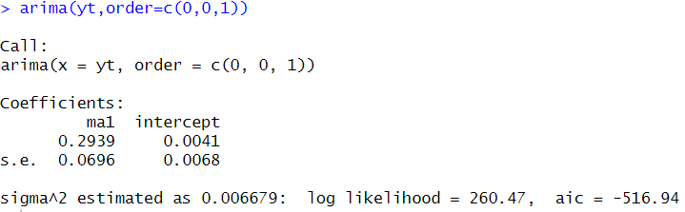
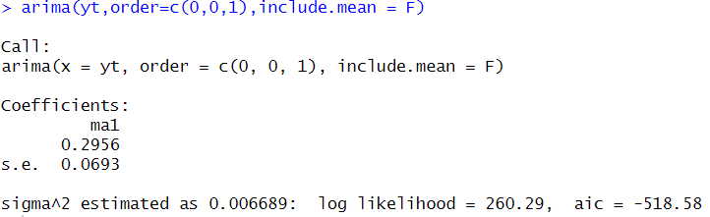
ARMA model analysis flowchart
Data
Example(oil.price):
R code:
arima(data, order=c(p,d,q))
Test for
stationary
Model specification
Parameter estimation
?
Model diagnostic
Model selection

Slide 27
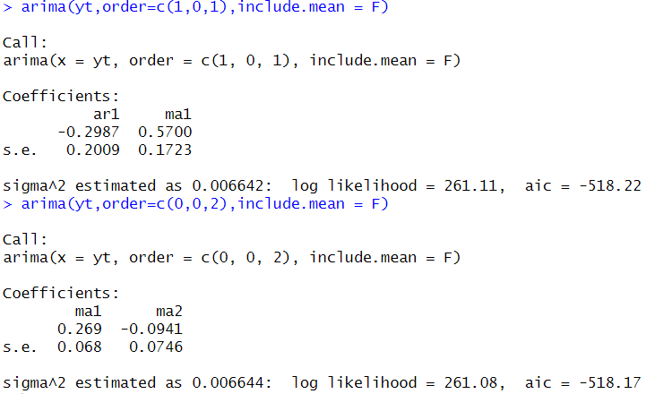
ARMA model analysis flowchart
Data
Example(oil.price):
R code:
arima(data, order=c(p,d,q))
Test for
stationary
Model specification
Parameter estimation
?
Model diagnostic
Model selection

Slide 28
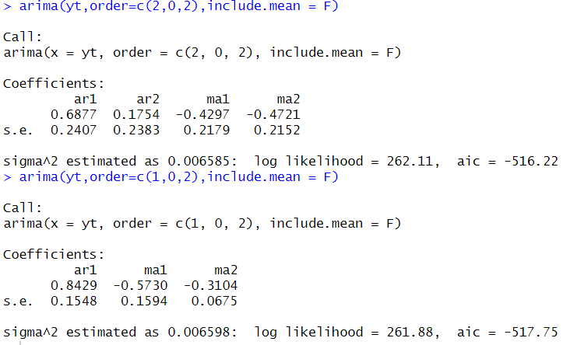
ARMA model analysis flowchart
Data
Example(oil.price):
R code:
arima(data, order=c(p,d,q))
Test for
stationary
Model specification
Parameter estimation
?
Model diagnostic
Model selection

Slide 29
ARMA model analysis flowchart
Data
Example(oil.price):
Test for
stationary
Model specification
Maximum Likelihood Estimation(MLE)
Least Square Estimation(LSE)
Parameter estimation
Check significance of parameters
Model diagnostic
All of parameters are significance
Model selection

Slide 30
8. Model diagnostic

Slide 31

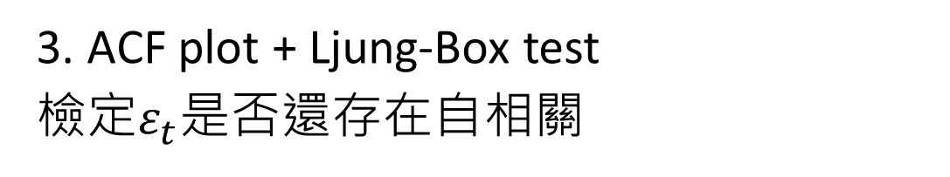
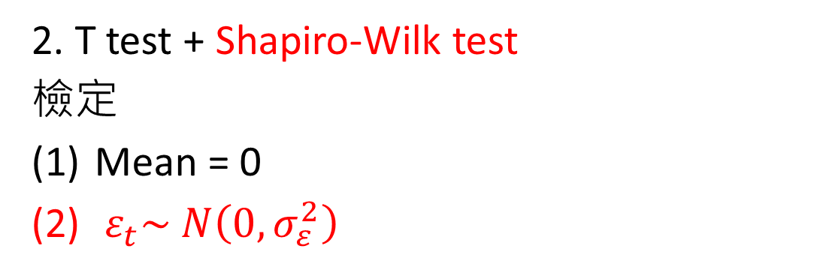
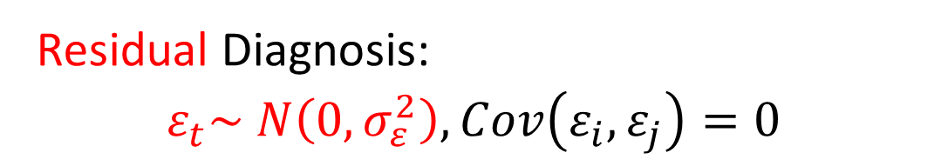
ARMA model analysis flowchart
Data
Residual Diagnosis:
$$ε_{t}\sim N\left(0,σ_{ε}^{2}\right), Cov\left(ε_{i}, ε_{j}\right)=0$$
Test for
stationary
1. Time series plot + histogram + QQ-plot
檢查是否滿足
Symmetric
Mean = 0
Outliers
Model specification
Parameter estimation
2. T test + Shapiro-Wilk test
檢定
Mean = 0
$ε_{t}\sim N\left(0,σ_{ε}^{2}\right)$
Model diagnostic
?
Model selection
3. ACF plot + Ljung-Box test
檢定$ε_{t}$是否還存在自相關
註:
若$ε_{t}服從$其他分布，則Shapiro-Wilk test更改成K-S test

Slide 32
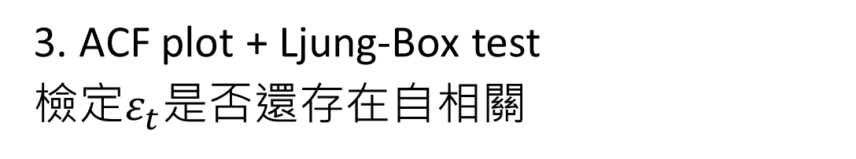
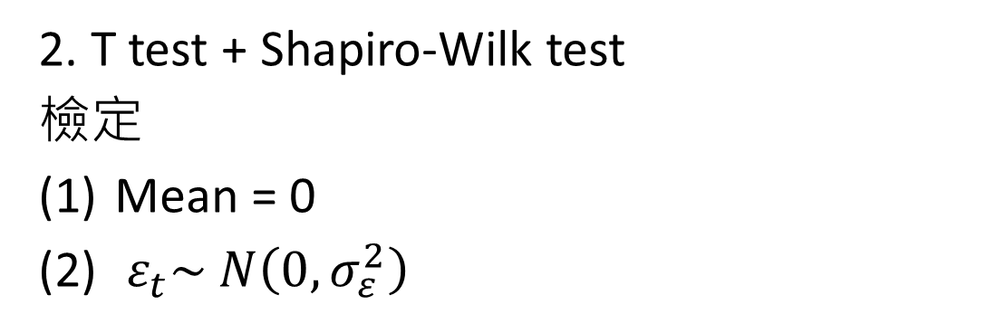
ARMA model analysis flowchart
Data
Test for
stationary
Model specification
Refit the model
Parameter estimation
Outliers
Ignore outliers
1. Time series plot + histogram + QQ-plot
檢查是否滿足
Symmetric
Mean = 0
Outliers
2. T test + Shapiro-Wilk test
檢定
Mean = 0
$ε_{t}\sim N\left(0,σ_{ε}^{2}\right)$
Model diagnostic
Model selection
3. ACF plot + Ljung-Box test
檢定$ε_{t}$是否還存在自相關

Slide 33
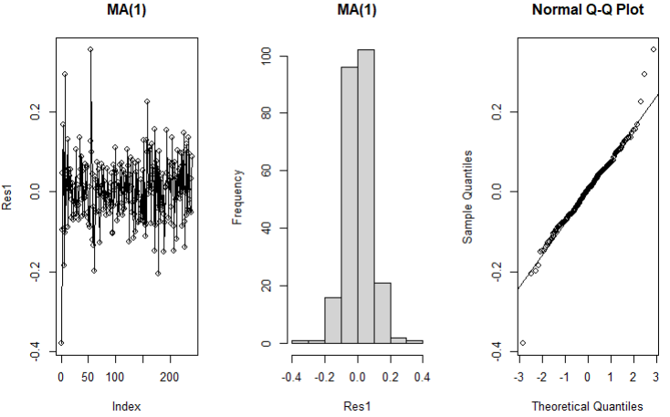

ARMA model analysis flowchart
Data
1. Time series plot + histogram + QQ-plot
檢查是否滿足
Symmetric
Mean = 0
Outliers
Test for
stationary
Model specification
Example(oil.price):
Parameter estimation
Model diagnostic
?
Model selection

Slide 34
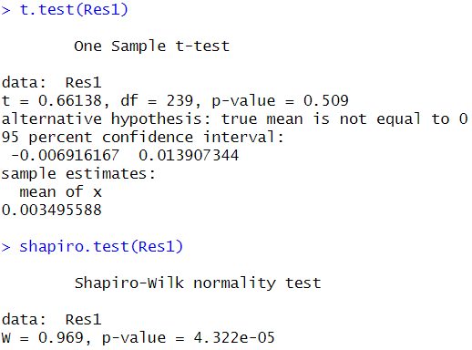
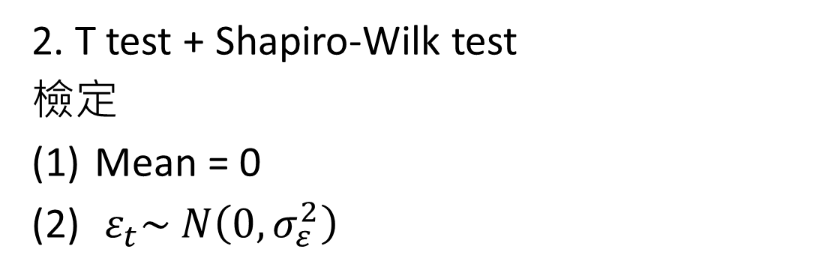
ARMA model analysis flowchart
Data
2. T test + Shapiro-Wilk test
檢定
Mean = 0
$ε_{t}\sim N\left(0,σ_{ε}^{2}\right)$
Test for
stationary
Model specification
Example(oil.price):
Parameter estimation
Model diagnostic
?
Model selection

Slide 35
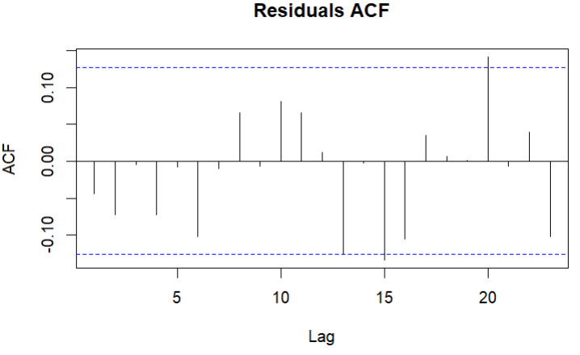
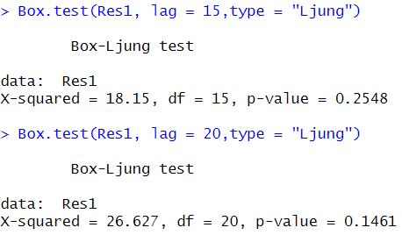
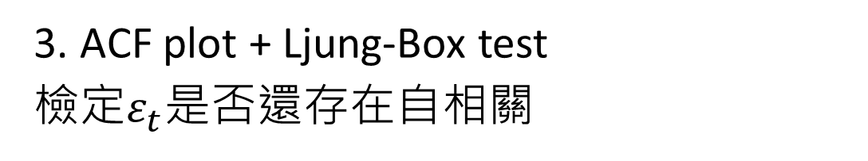
ARMA model analysis flowchart
Data
Test for
stationary
3. ACF plot + Ljung-Box test
檢定$ε_{t}$是否還存在自相關
Model specification
Example(oil.price):
Parameter estimation
Model diagnostic
?
Model selection

Slide 36
9. Model selection

Slide 37
ARMA model analysis flowchart
Data
Criteria of model selection:
通過的檢定個數
AIC and BIC
Test for
stationary
Model specification
Example(oil.price):
Parameter estimation
 | T test | Shapiro-Wilk test | Ljung-Box test | AIC
MA(1) | 通過 | 不通過 | 通過 | -518.58
ARMA(1,2) | 通過 | 不通過 | 通過 | -517.75
Model diagnostic
Model selection

Slide 38

10. Conclusion

Slide 39

ARMA model analysis flowchart
Data
ADF-test (H0: Data is non-stationary)
KPSS-test (H0: Data is stationary)
ACF plot
Non-stationary
Stationary
ACF plot: Cut-off at lag q => MA(q)
PACF plot: Cut-off at lag p => AR(p)
EACF plot: ARMA(p,q)
Box-Cox transformation
Difference
All of parameters are significance
No outliers or ignore outliers
Check significance of parameters
Time series plot +
histogram + QQ-plot
Symmetric
Mean = 0
Outliers
T test + Shapiro-Wilk test
ACF plot + Ljung-Box test
Some parameters are non-significance
Refit the model
Criteria of model selection:
通過的檢定個數
AIC and BIC
Remove the most non-significance parameter
Outliers

Slide 40

11. auto.arima()

Slide 41
auto.arima()
Data
Criteria of model selection: AIC, BIC and HQIC
auto.arima()
優點:
減少模型選擇的主觀性
快速方便
適用性高 (可考慮季節性、趨勢性)
缺點:
計算時間長
Overfitting
模型可能包含不顯著參數
不一定能找到最適模型
Model

Slide 42
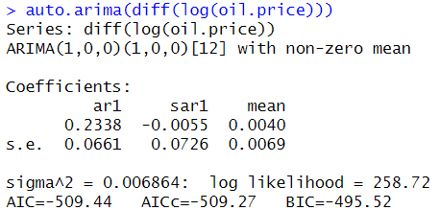
auto.arima()
Data
Example(oil.price):
auto.arima()
Model

Slide 43
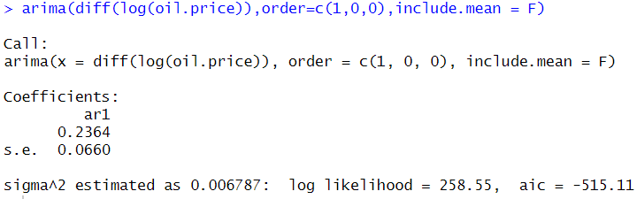

auto.arima()
Data
Example(oil.price):
auto.arima()
Model

Slide 44
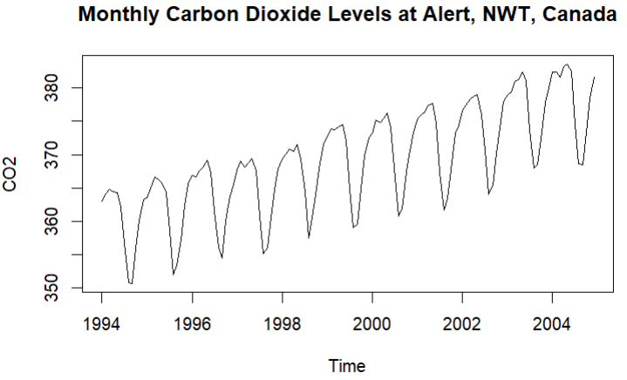
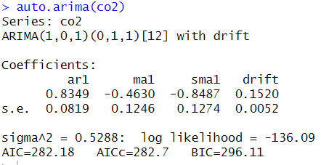
auto.arima()
Data
Example(co2):
auto.arima()
Model

Slide 45
Thanks for listening!

